Slide 1
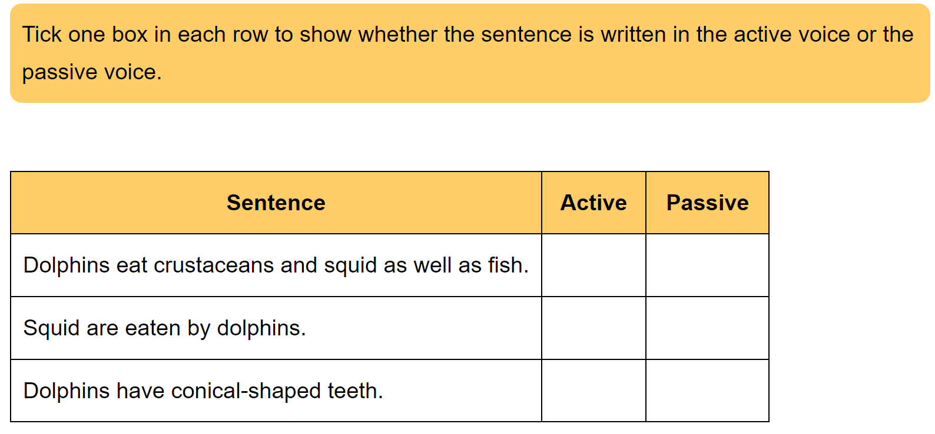
Active versus passive voice

Slide 2
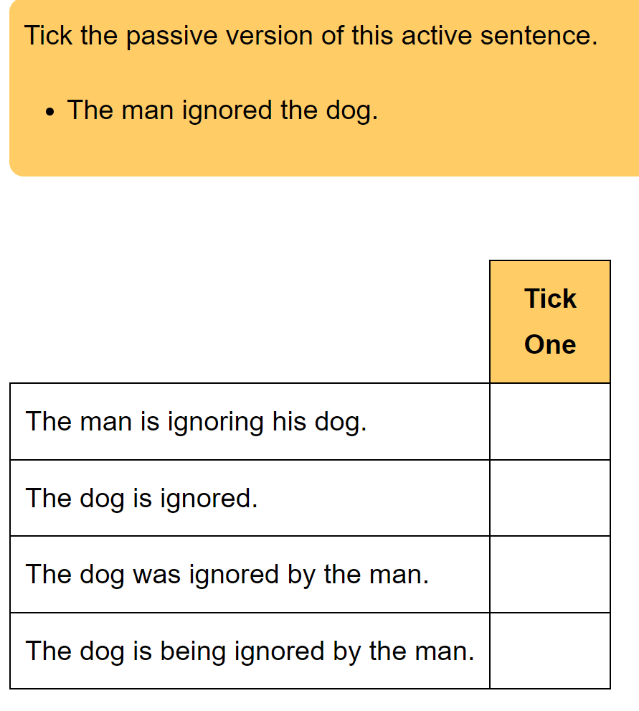

Slide 3
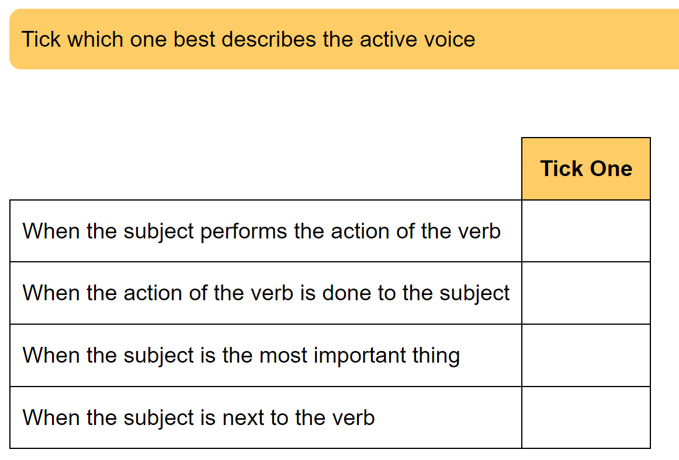

Slide 4
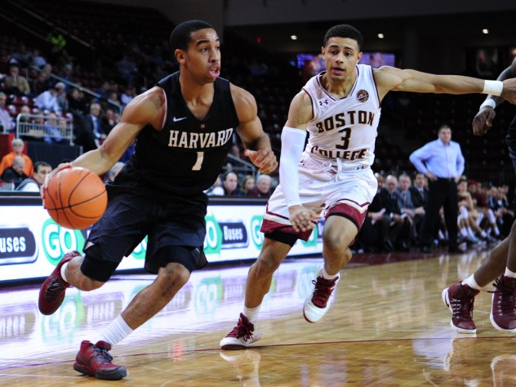
SUBJECT VERB OBJECT
The teenager bounced the basketball.
Subject = Verb = Object =

Slide 5
SUBJECT VERB OBJECT
The teenager bounced the basketball.
Subject = The teenager/ teenager Verb = bounced Object = the basketball /basketball

Slide 6
It may be more than one word

Slide 7
Subject, verb, object - write SVO next to them
Daniel laid the table.
Marcia counted her chocolate coins.
My dad painted the fence.
The children picked flowers in the meadow.
The dog chewed his bone.
The baby ate the banana.
Mum baked some very tasty cakes.
Harry painted a picture.
S
V
O

Slide 8
Subject, verb, object - write SVO next to them
Daniel laid the table.
Marcia counted her chocolate coins.
My dad painted the fence.
The children picked flowers in the meadow.
The dog chewed his bone.
The baby ate the banana.
Mum baked some very tasty cakes.
Harry painted a picture.
S
V
O
S
V
O
S
V
O
S
V
O
S
V
O
S
V
O
S
V
O
S
V
O

Slide 9
Identifying SVO can be a SATs question too

Slide 10
What is an active verb?
An active verb is where the subject carries out the action:
The teenager bounced the basketball.

Slide 11
What is a passive verb?
The subject has the action done to it. So the subject undergoes the action of the verb (e.g. They were knighted as opposed to the active form He knighted them). They were knighted. – is the passive voice
They were knighted by the King. – is also the passive voice.
Active:
The teenager bounced the basketball.
Passive:
The basketball was bounced by the teenager.
> This creates a change in emphasis. The passive voice is quite often used to show formality.
Tip: if you can add ‘by zombies’ after the sentence, nine times out of ten it will be the passive voice.
The passive voice often has ‘by…’ in it, but does not have to.

Slide 12
Achieve
1.Change the active voice sentences below to passive voice:
The burglar stole £5000.
_________________________________________________________________________________
B. Tina sipped her cup of tea, contentedly.
_________________________________________________________________________________
C. Stealthily, Mrs Cull broke out of the classroom.
_________________________________________________________________________________
D. Danny scored the winning goal.
_________________________________________________________________________________
E. Auntie Jen baked us a beautiful banana bread.
_________________________________________________________________________________
2. Now write five of your own sentences, each containing the passive voice.
_________________________________________________________________________________
_________________________________________________________________________________
_________________________________________________________________________________
__________________________________________________________________________________________________________________________________________________________________

Slide 13
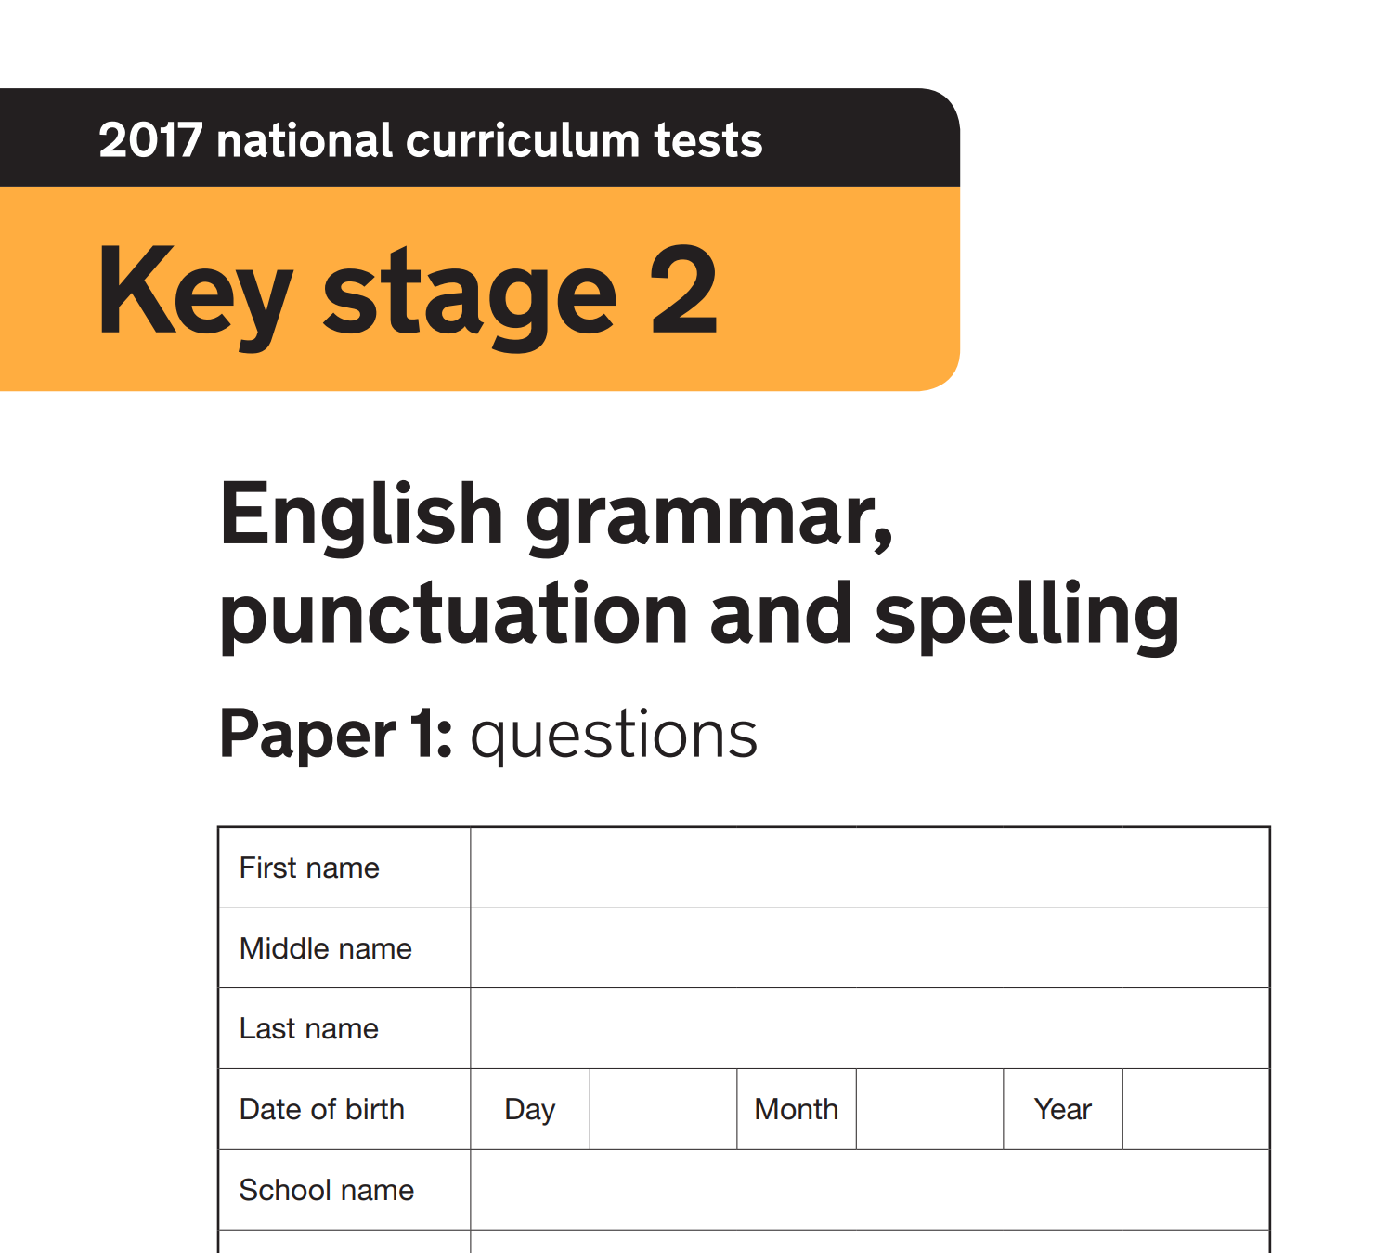
Help yourself to a practice SATs paper (2017)

